Slide 1
Synchronization

Slide 2
Distributed system is a collection of computers connected via the high speed communication network.
In the distributed system, the hardware and software components communicate and coordinate their actions by message passing.
Each node in distributed systems can share their resources with other nodes.
So, there is need of proper allocation of resources to preserve the state of resources and help coordinate between the several processes.
To resolve such conflicts, synchronization is used. Synchronization in distributed systems is achieved via clocks.

Slide 3
In a centralized system, time is unambiguous.
When a process wants to know the time, it makes a system call and the kernel tells it.
If process A asks for the time. and then a little later process B asks for the time, the value that B gets will be higher than (or possibly equal to) the value A got. It will certainly not be lower.
Thus, in such systems, there is a clear ordering of events and there is no ambiguity about the times at which these events occur.
In a distributed system, achieving agreement on time is not trivial.
In distributed system, To avoid such problems, we have to make sure that all computers in network have a same time stamps. In other words, Clock time of each computer must be synchronized.

Slide 4
In distributed systems, there is no global clock or common memory. Each processor has its own internal clock and its own notion of time.
These clocks can easily drift apart by several seconds per day, accumulating significant errors over time.
This clearly poses serious problems to applications that depend on a synchronized notion of time.
For most applications and algorithms that run in a distributed system, we need to know time in one or more of the following contexts:
The time of the day at which an event happened on a specific machine in the network.
The time interval between two events that happened on different machines in the network.
The relative ordering of events that happened on different machines in the network.

Slide 5
Physical Clocks
Nearly all computers have a circuit for keeping track of time.
Despite the widespread use of the word "clock" to refer to these devices, they are not actually clocks in the usual sense.
Timer is perhaps a better word. A computer timer is usually a precisely machined quartz crystal. When kept under tension, quartz crystals oscillate at a well-defined frequency that depends on the kind of crystal, how it is cut, and the amount of tension.
Associated with each crystal are two registers, a counter and a holding register.
Each oscillation of the crystal decrements the counter by one. When the counter gets to zero, an interrupt is generated and the counter is reloaded from the holding register.
In this way, it is possible to program a timer to generate an interrupt 60 times a second, or at any other desired frequency.
Each interrupt is called one clock tick.

Slide 6
When the system is booted, it usually asks the user to enter the date and time
Most computers have a special battery-backed up CMOS RAM so that the date and time need not be entered on subsequent boots.
At every clock tick, the interrupt service procedure adds one to the time stored in memory. In this way, the (software) clock is kept up to date.
With a single computer and a single clock, it does not matter much if this clock is off by a small amount. Since all processes on the machine use the same clock, they will still be internally consistent.

Slide 7
As soon as multiple CPUs are introduced, each with its own clock, the situation changes radically.
Although the frequency at which a crystal oscillator runs is usually fairly stable, it is impossible to guarantee that the crystals in different computers all run at exactly the same frequency.
In practice, when a system has n computers, all n crystals will run at slightly different rates, causing the (software) clocks gradually to get out of synch and give different values when read out.
This difference in time values is called clock skew.

Slide 8
Global Positioning System
GPS, which is an acronym for global positioning system.
Determining one's geographical position anywhere on Earth
Initially it is used for military applications
Navigation
Location
For example, GPS phones now allow to let callers track each other's position, a feature which may show to be extremely handy when you are lost or in trouble.

Slide 9
GPS operates independently of the users internet connection or telephone signal.
But their presence increases the effectiveness of GPS positioning.

Slide 10
GPS uses 29 satellites each circulating in an orbit at a height of approximately 20,000 km.
Orbiting the earth every 12 hour.
A satellite continuously broadcasts its position, and time stamps each message with its local time.
This broadcasting allows every receiver on Earth to accurately compute its own position using, only three satellites.
To explain, let us first assume that all clocks, including the receiver's, are synchronized.

Slide 11
In order to compute a position, consider first the two-dimensional case
Two satellites are drawn, along with the circles representing points at the same distance from each respective satellite.
The y-axis represents the height.
The x-axis represents a straight line along the Earth’s surface at sea level.
Ignoring the highest point, we see that the intersection of the two circles is a unique point

Slide 12
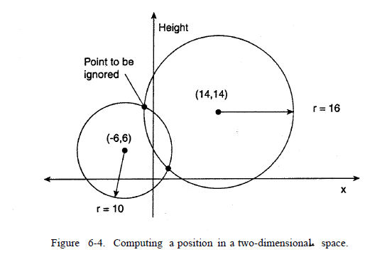

Slide 13
This principle of intersecting circles can be expanded to three dimensions
we need three satellites to determine the longitude, latitude, and altitude of a receiver on Earth.
This positioning is all fairly straightforward, but matters become complicated when we can no longer assume that all clocks are perfectly synchronized.
There are two important real-world facts that we need to take into account:
It takes a while before data on a satellite's position reaches the receiver
The receiver's clock is generally not in synch with that of a satellite.

Slide 14
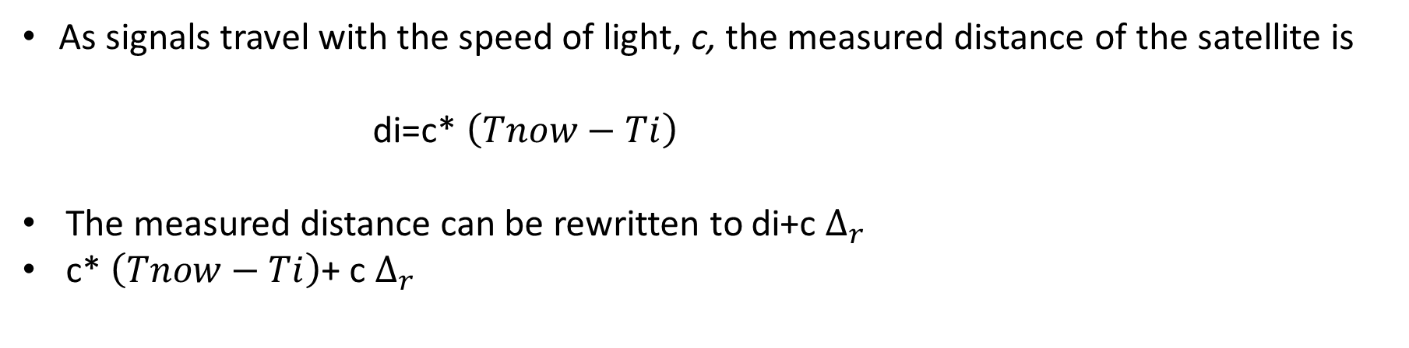
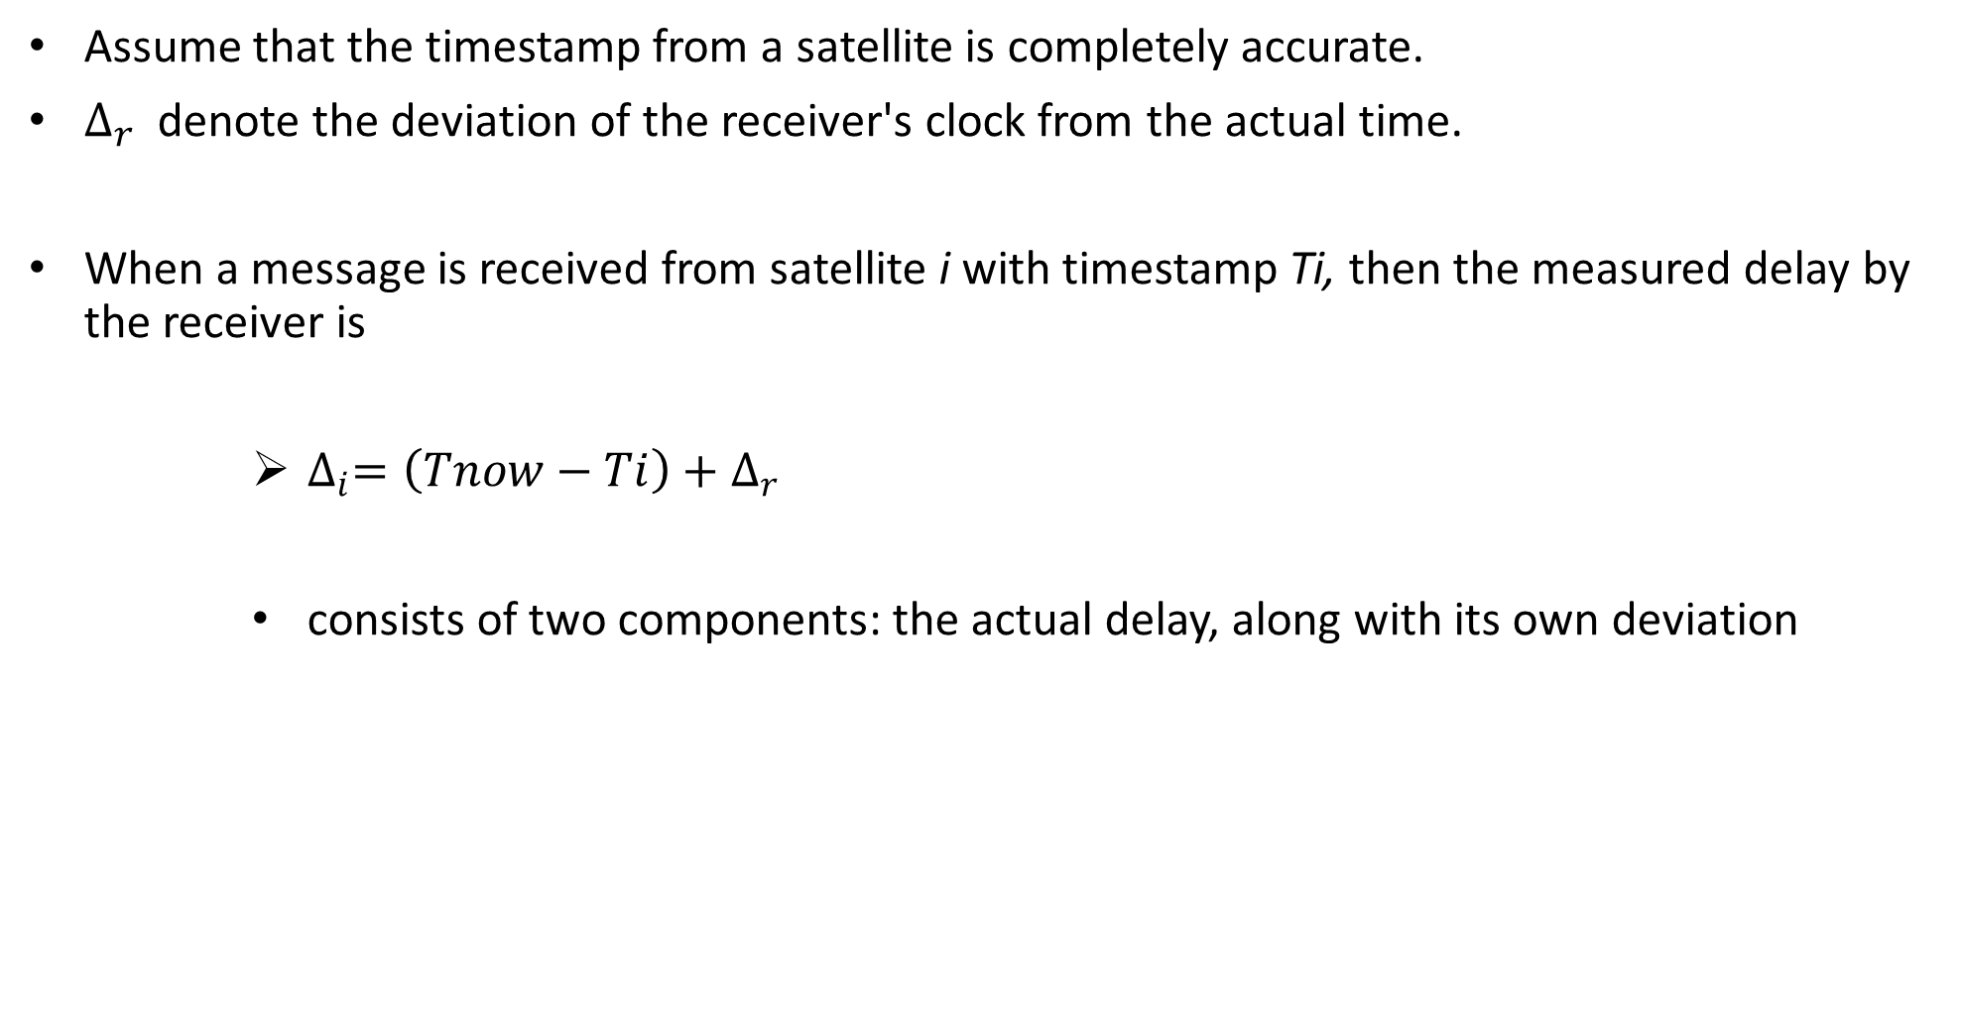
Assume that the timestamp from a satellite is completely accurate.
$∆_{r}$denote the deviation of the receiver's clock from the actual time.
When a message is received from satellite i with timestamp Ti, then the measured delay by the receiver is
$∆_{i}=\left(Tnow−Ti\right)+∆_{r}$
consists of two components: the actual delay, along with its own deviation
As signals travel with the speed of light, c, the measured distance of the satellite is
di=c* $\left(Tnow−Ti\right)$
The measured distance can be rewritten to di+c $∆_{r}$
c* $\left(Tnow−Ti\right)$+ c $∆_{r}$

Slide 15

The real distance is simply computed as:
Where xi,yi,zi are the coordinates of satellite i
So far, we have assumed that measurements are perfectly accurate. Of course,they are not.

Slide 16
GPS does not take leap seconds into account.
Such an error can be easily compensated for in software. However, there are many other sources of errors
atomic clocks in the satellites are not always in perfect synch.
The position of a satellite is not known precisely
The signal propagation speed is not constant (as signals slow down when entering, e.g., the ionosphere), and so on.
Moreover, we all know that the earth is not a perfect sphere, leading to further corrections.

